Slide 1

Modelling and validation of wind turbine wake superposition - Using wind farm data
Midterm meeting - 16/04/2018
Ottelien Bossuyt
DTU Student nr: s163141 TU Delft Student nr: 4624351

Slide 2
Agenda
Introduction
Wake models & Superposition methods
Data
BEACon & LES comparison
LES superposition
Next steps

Slide 3
Introduction

Slide 4
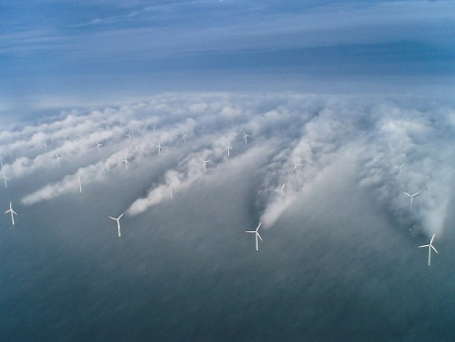
Introduction
Large wind farms
Lower wind speed and power production
Interaction of multiple wakes
Simple/engineering models of single wakes
Can these models be superposed?
Real measurements (BEACon) simulation data (LES)
http://www.noaanews.noaa.gov/stories2011/images/vattenfall-image_300.jpg

Slide 5
Wake models & Superposition methods

Slide 6
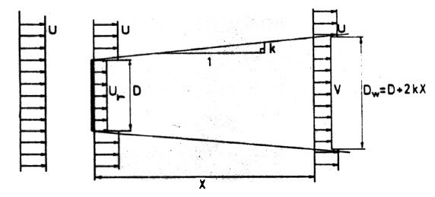
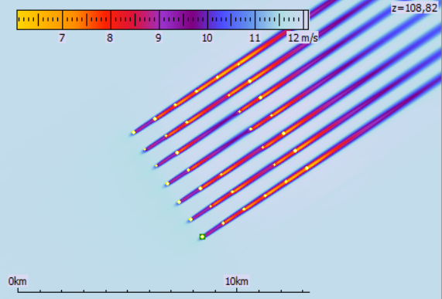
Wake models
Jensen model
Ainslie model
Larsen model
Infinite wind farm boundary layer
Frandsen model
Bastankhah & Porté-Agel
Fuga
Dynamic Wake Meandering

Slide 7
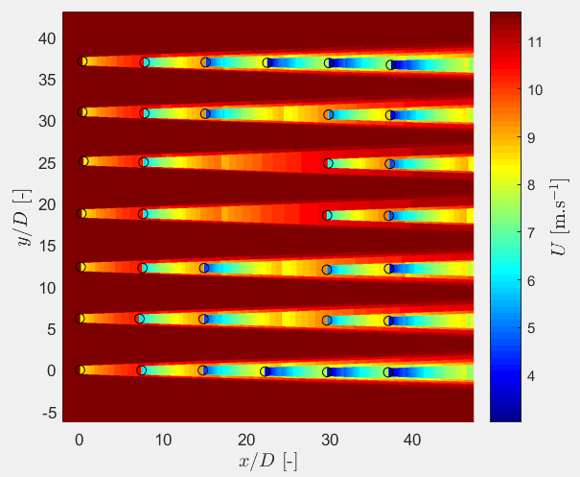
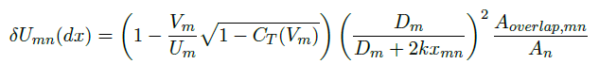
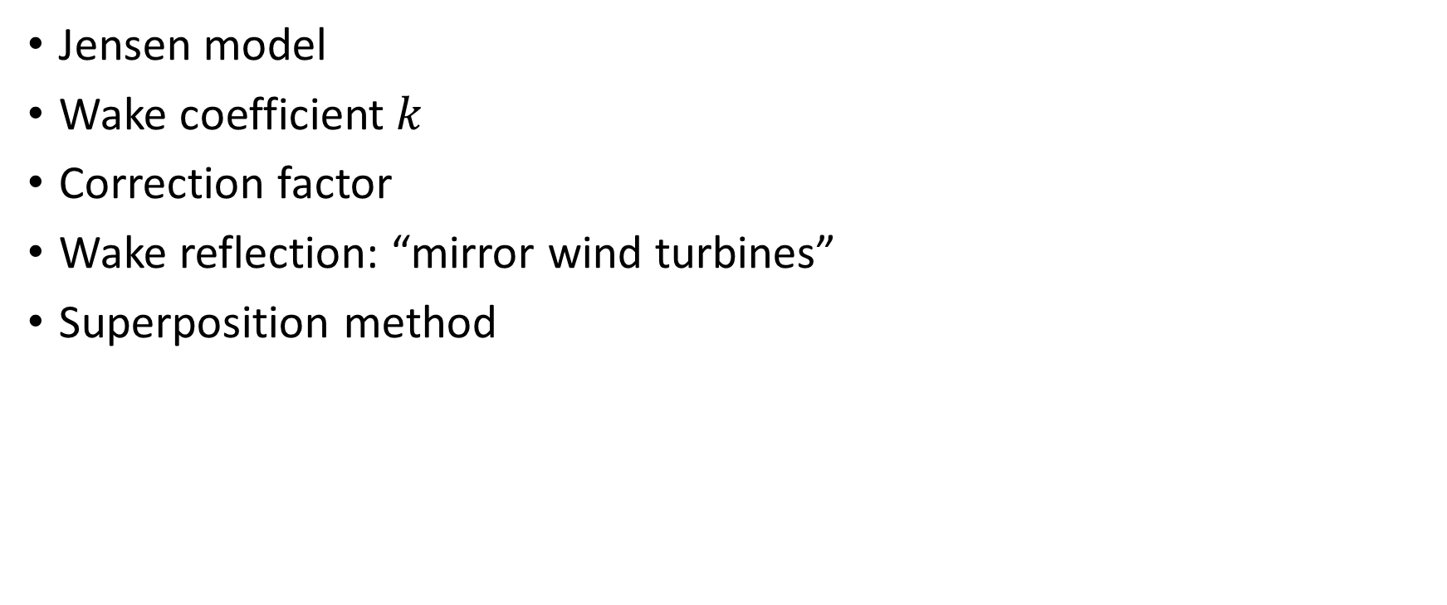
Park model
Jensen model
Wake coefficient $k$
Correction factor
Wake reflection: “mirror wind turbines”
Superposition method
A note on wind generator interaction , N. O. Jensen, 1983
A simple model for cluster efficiency, I. Katic, J. Højstrup, and N. O. Jensen. Ewec’86 Proceedings, 1987
Results of wake simulations at the Horns Rev I and Lillgrund wind farms using the modified Park model, A. Peña Diaz, P.-E. Rethore, C. B. Hasager, and K. S. Hansen., 2013.
Validation of the revised WAsP Park model, O. S. Rathmann, B. O. Hansen, J. M. Leon, K. S. Hansen, and N. G. Mortensen. 2017.
Notes:
Quadratic + wake reflection + correction factor

Slide 8
Fuga
Linearized CFD model based on RANS equations
Look-up tables including stability
Linear wake summation
Implemented in WAsP
Linearised CFD models for wakes, S. Ott, J. Berg, and M. Nielsen. 2011

Slide 9
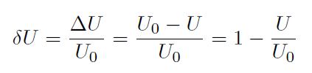
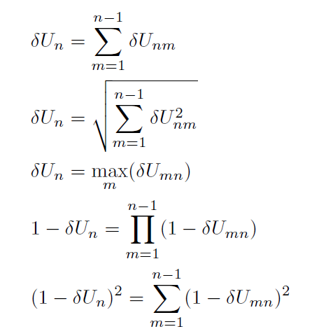
Superposition methods
Wake deficit
Linear superposition
Quadratic superposition
Maximum deficit
Geometric sum
Energy balance

Slide 10
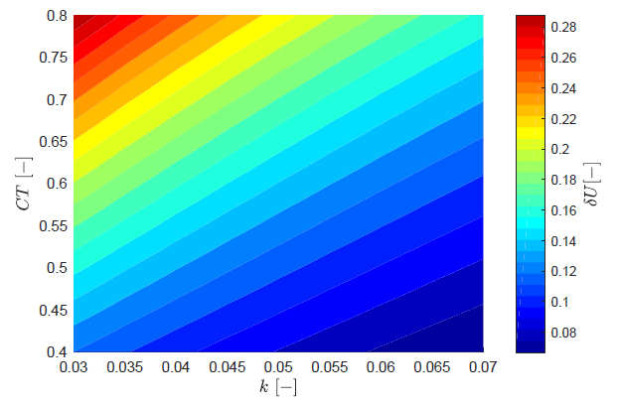
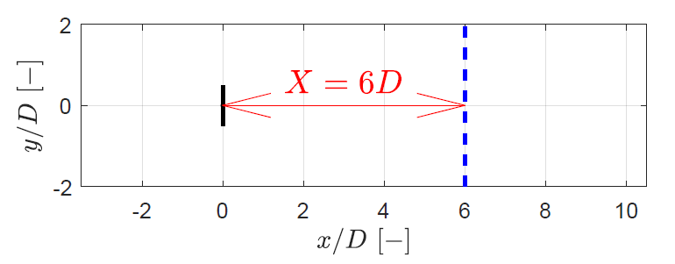
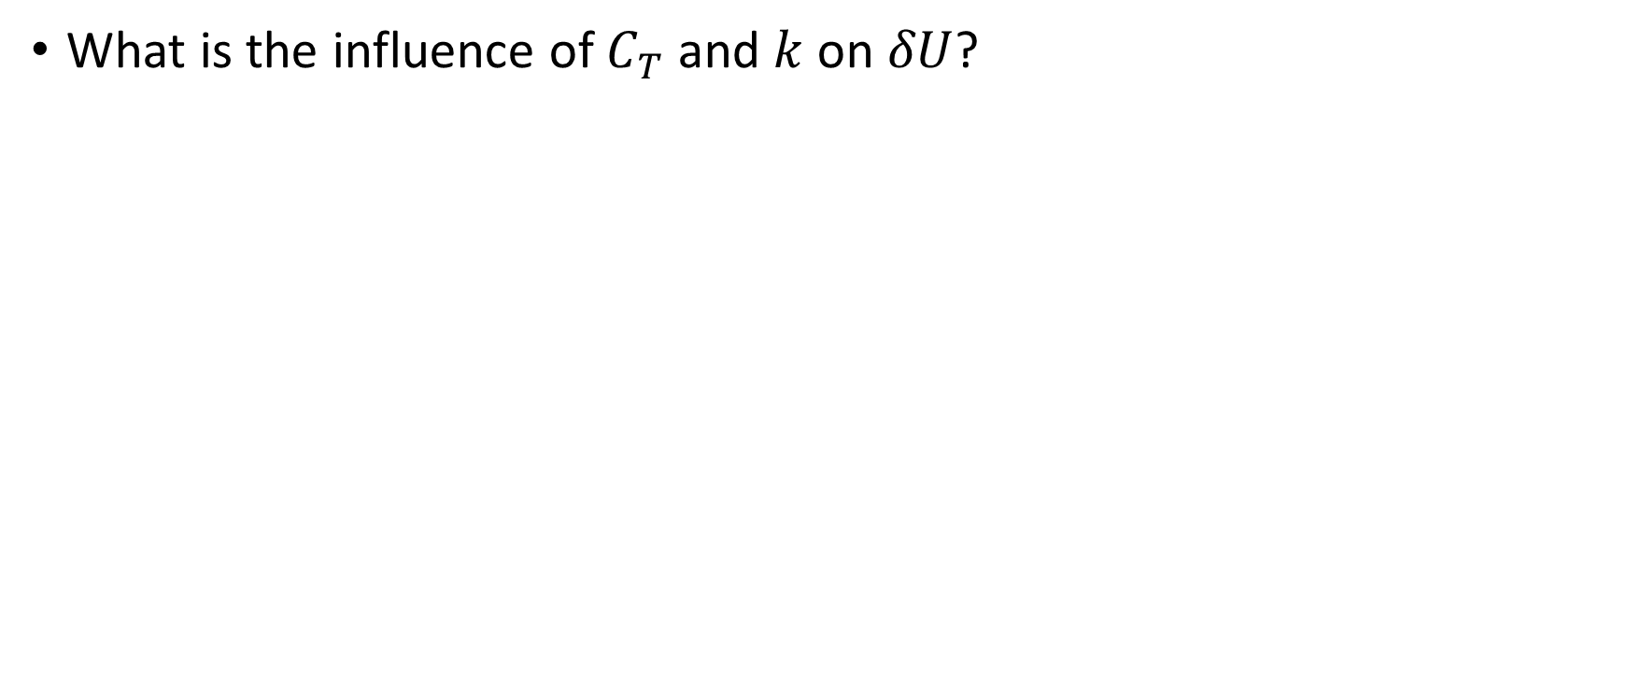
Park model – Sensitivity Study
What is the influence of $C_{T}$ and $k$on $δU$?
Notes:
dU ranges between 0,3 and 0,07 for wake deficit 7D behind wind turbine → Uo=10 → 2,3m/s difference

Slide 11
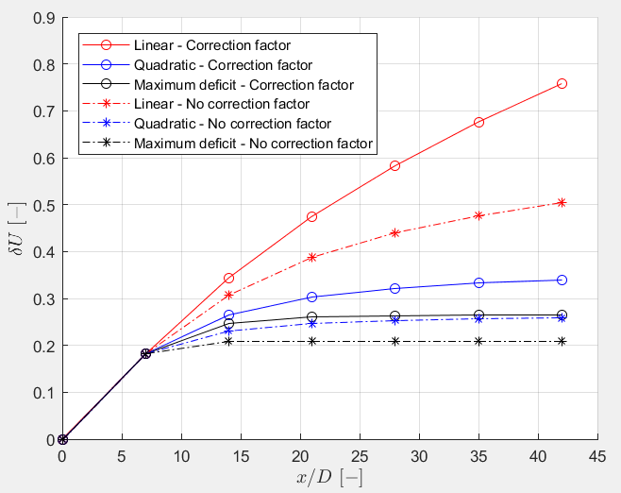
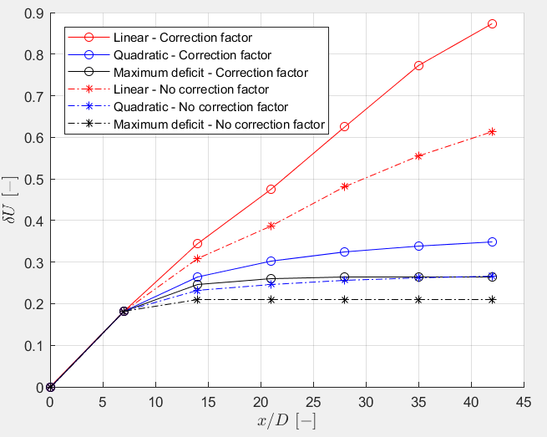
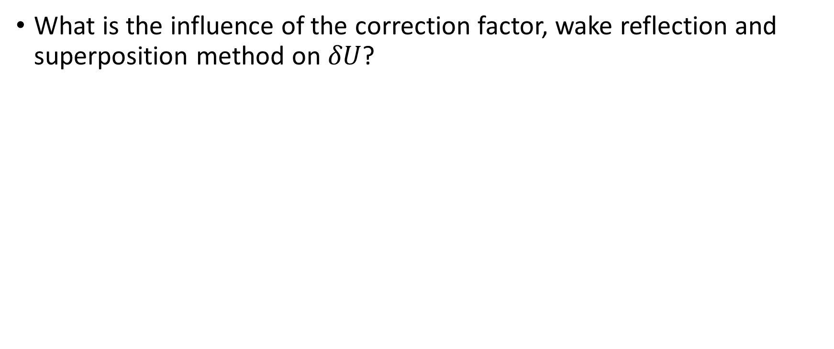
Park model – Sensitivity Study
What is the influence of the correction factor, wake reflection and superposition method on $δU$?
Without wake reflection With wake reflection
Notes:
7D between wind turbines
Wake reflection increases deltaU, especially for linear, minimal difference for quadratic and max
Correction factor has a big influence

Slide 12
Data

Slide 13
BEACon
Dual-Doppler radar system
Westermost Rough wind farm, east coast UK
Radial wind speeds combined into 3D Cartesian grid
Extract inflow profile: average inflow in cross-stream direction at each height
N. G. Nygaard, F. E. Brink, J. S. Gretlund, B. Hirth, J. Schroeder, and J. Guynes. Wake measurements in an offshore wind farm using dual-Doppler radars.

Slide 14
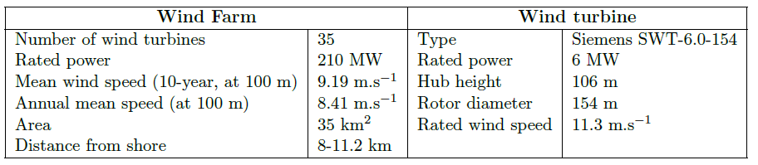
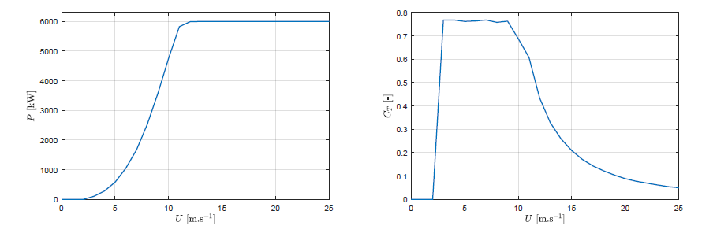
WMR wind farm & wind turbine

Slide 15
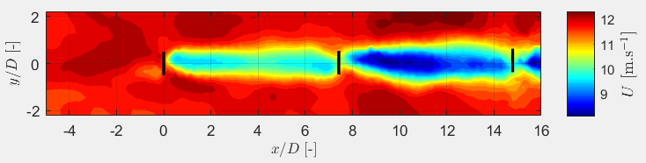
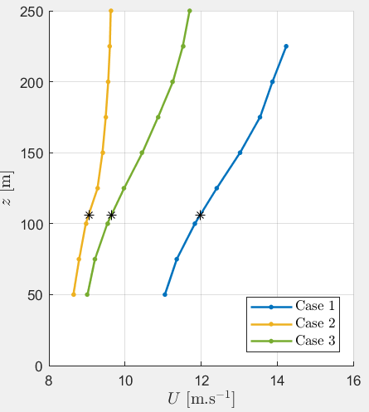
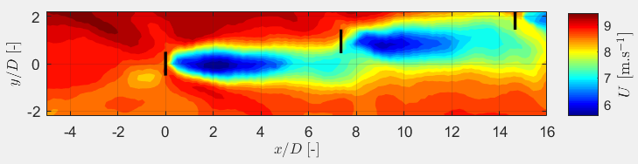
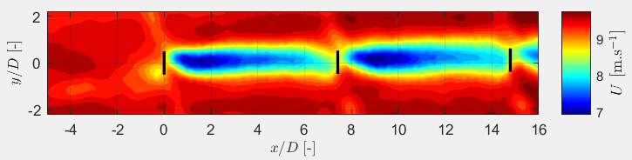
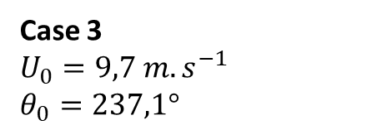
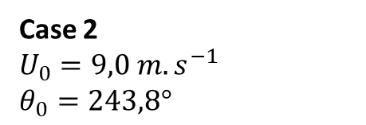
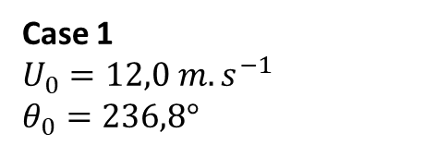
BEACon - Data sets
Case 1
$$U_{0}=12,0 m.s^{−1} \\ θ_{0}=236,8°$$
Case 2
$$U_{0}=9,0 m.s^{−1} \\ θ_{0}=243,8°$$
Case 3
$$U_{0}=9,7 m.s^{−1} \\ θ_{0}=237,1°$$
Notes:
Domains are rotated such that wind direction is from the west

Slide 16
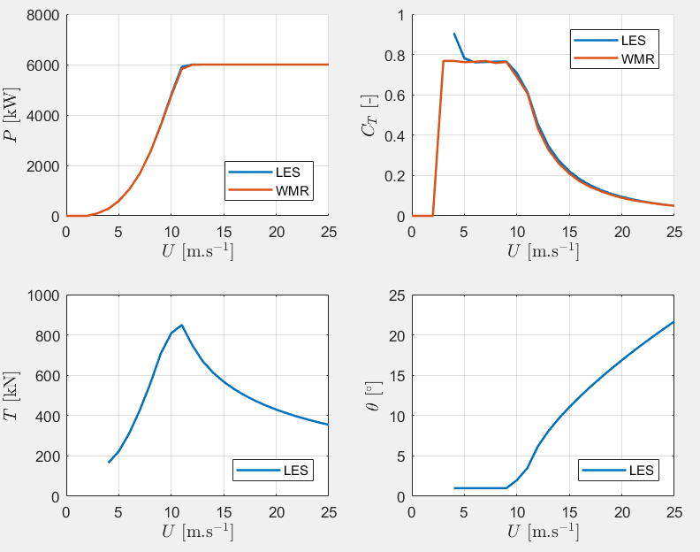
Large Eddy Simulation (LES)
EllipSys3D Solver
Wake behind actuator line model
Mann’s turbulent box
High computational cost
Time averaging
Spatial averaging: BEACon grid
Scaled DTU10MW WT
Block structured multigrid solution of 2D and 3D elliptic PDE’s, J. Michelsen, T. U. of Denmark, 1994.
General purpose ow solver applied to flow over hills, N. N. Sørensen, 1995,
Actuator line modeling of wind turbine wakes , N. Troldborg. 2009

Slide 17
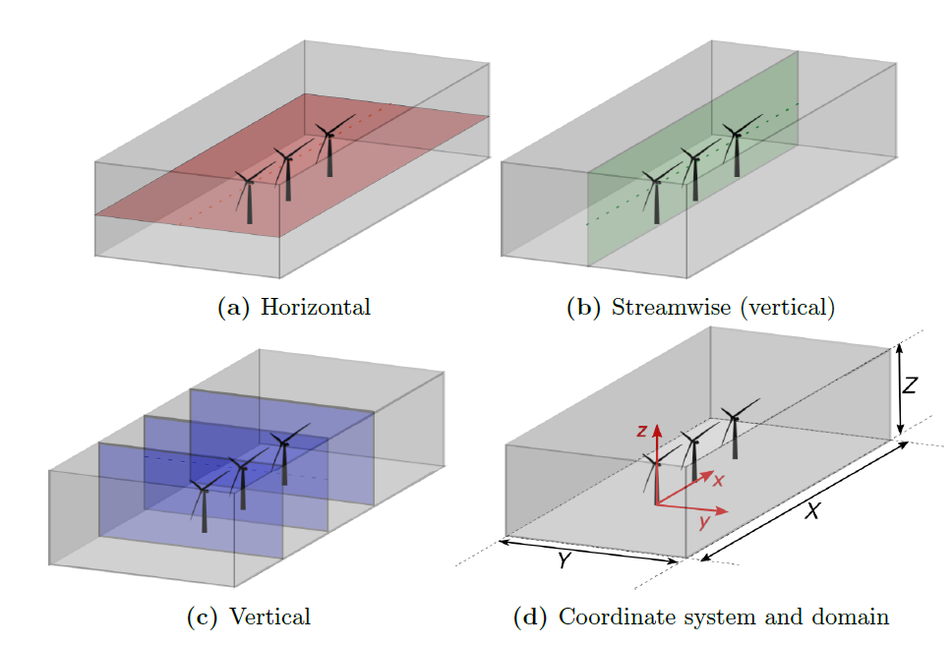
Data planes

Slide 18

Comparison BEACon & LES
Focus on Case 3 ($U_{0}=9,7 m.s^{−1}$)

Slide 19
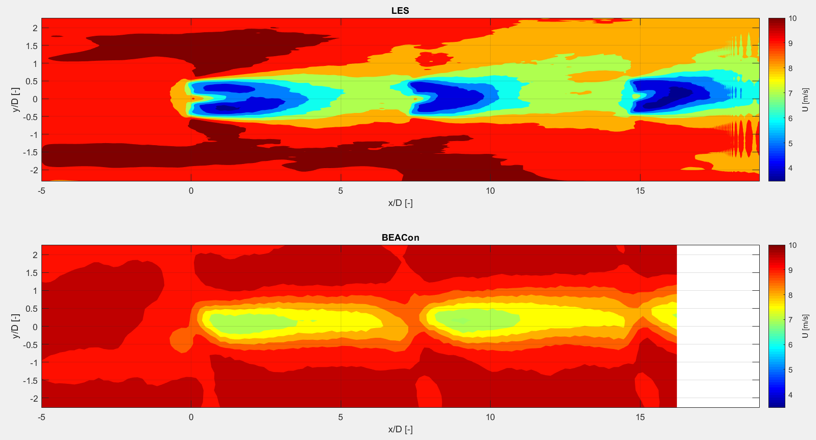
BEACon & LES
Horizontal plane at 100 m height

Slide 20
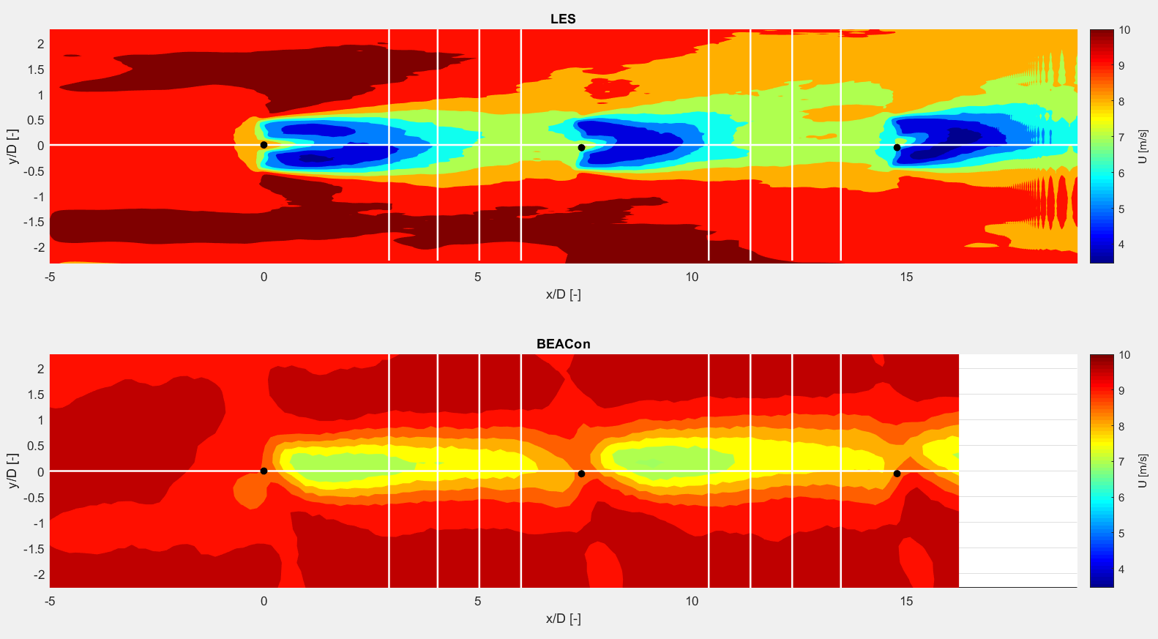

BEACon & LES
WT$+\sim 3,4,5,6 D$
Streamwise line through first wind turbine

Slide 21
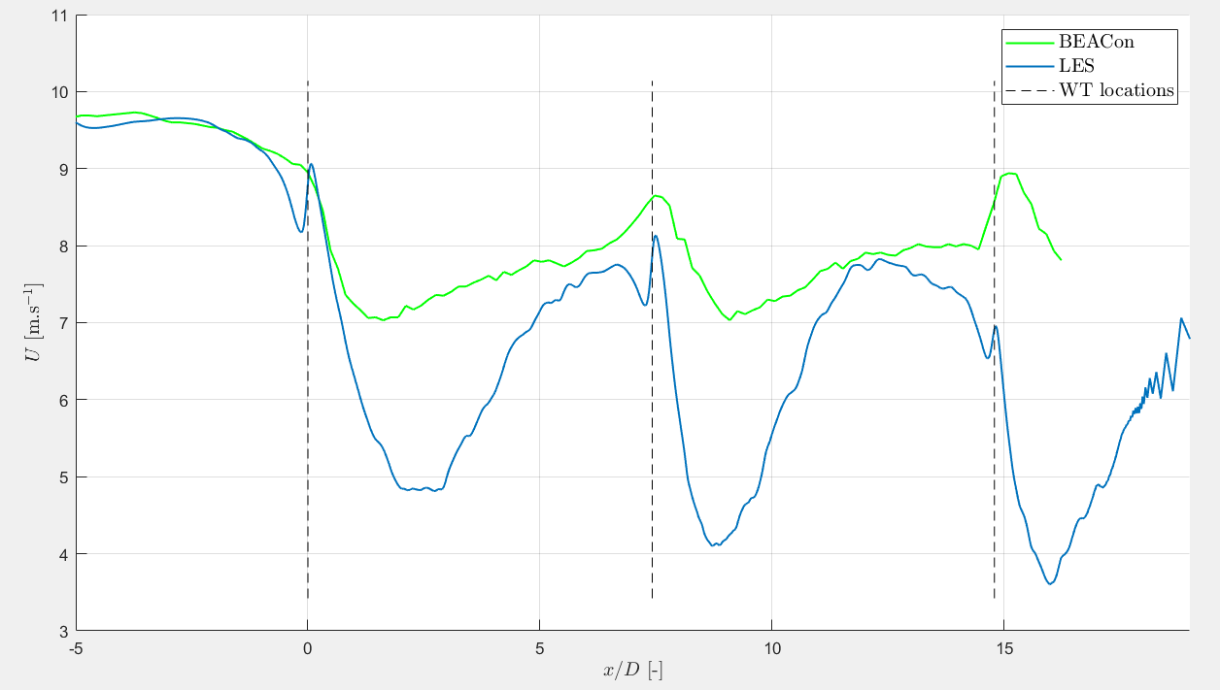
BEACon & LES - Streamwise
Wind profile along streamwise line at 100 m height

Slide 22
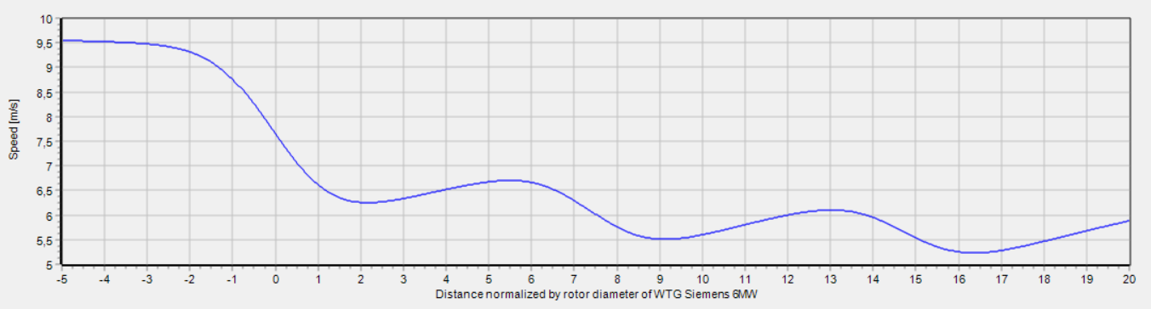
Fuga
Wind profile along streamwise line at 98,46 m height

Slide 23
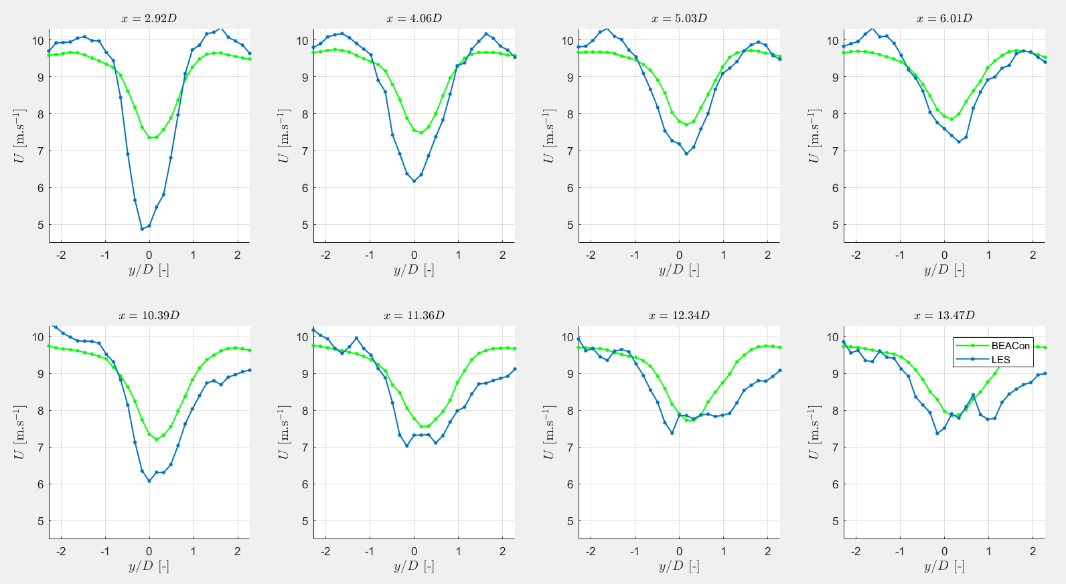
BEACon & LES – Horizontal profiles
Horizontal profiles at 100 m height

Slide 24

LES superposition
Focus on Case 1 ($U_{0}=12 m.s^{−1})$

Slide 25
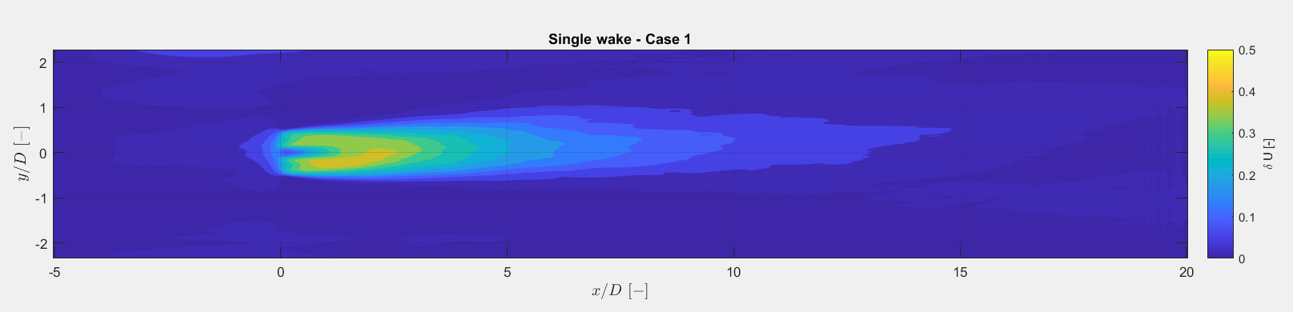
LES superposition
Horizontal plane at 100 m height
Case 1: yaw error of -1,06°
Notes:
Pos yaw: yawed counterclockwise (seen from above)

Slide 26
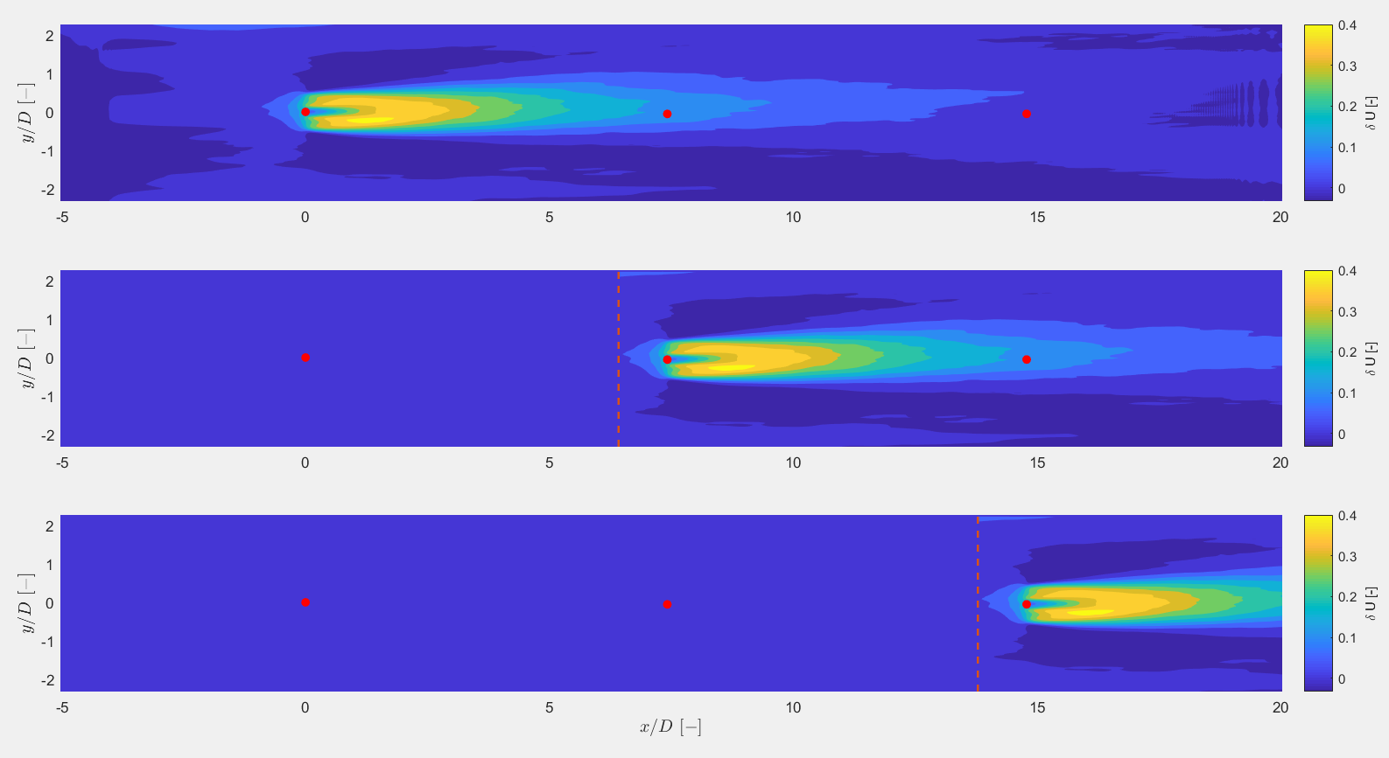
LES superposition
Individual fields will be superposed
Notes:
Should be done: scaling of wind field taking into account the descreased wind speed of the downstream wind turbines

Slide 27
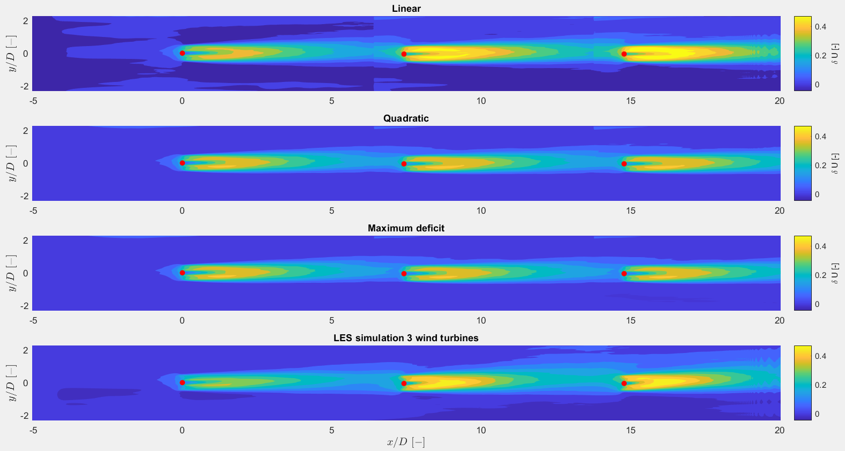
LES Superposition

Slide 28
LES Superposition
Maximum wake deficit / Minimum velocity
Wake profile along streamwise line
Horizontal profiles at different downstream distances
Wake boundary

Slide 29
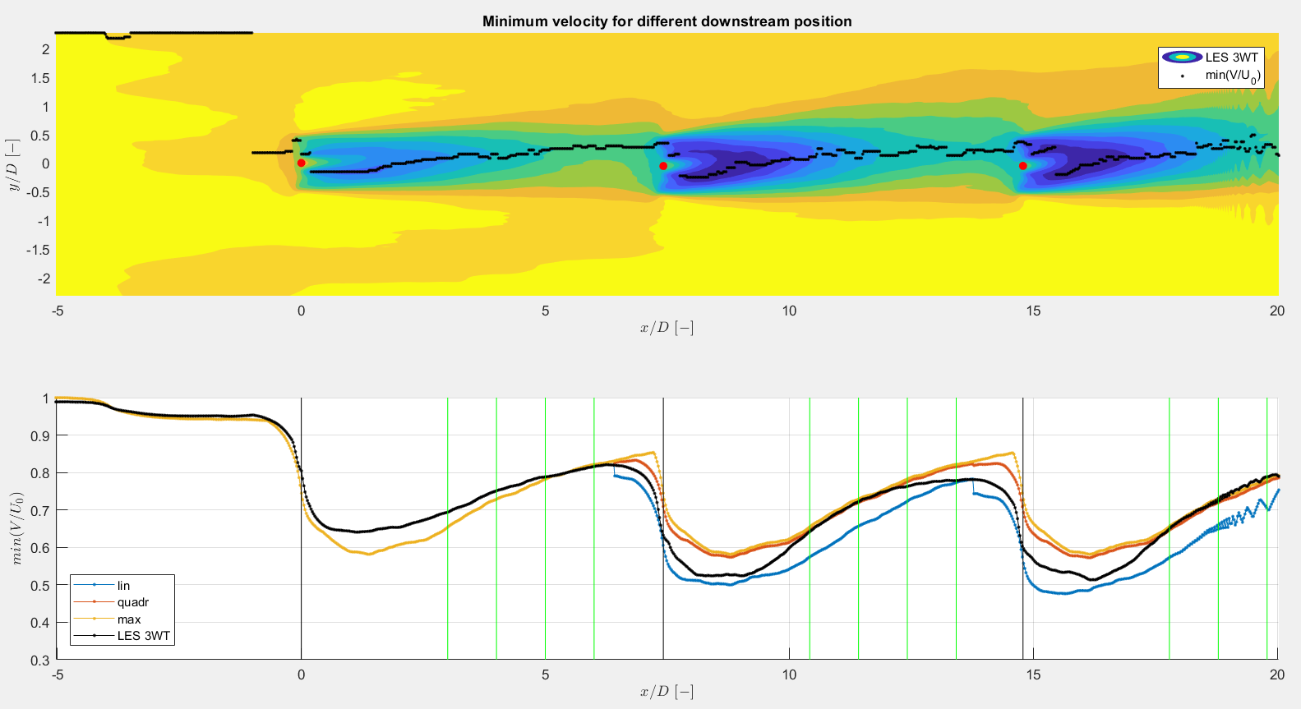
LES Superposition

Slide 30
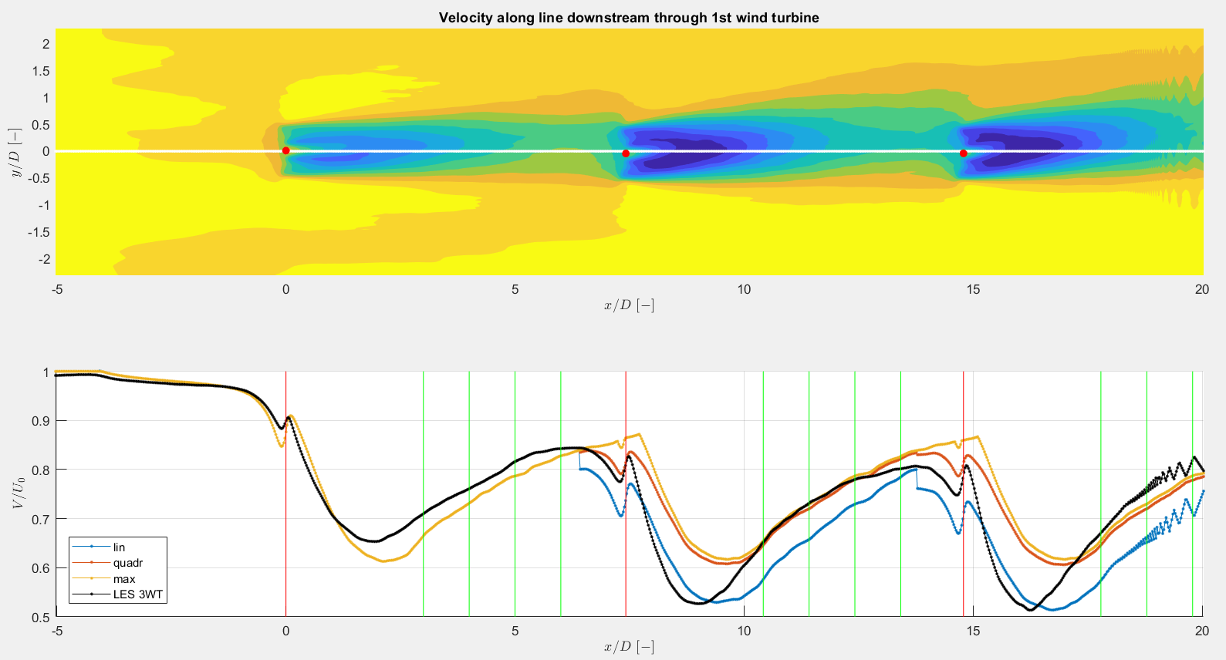
LES Superposition

Slide 31
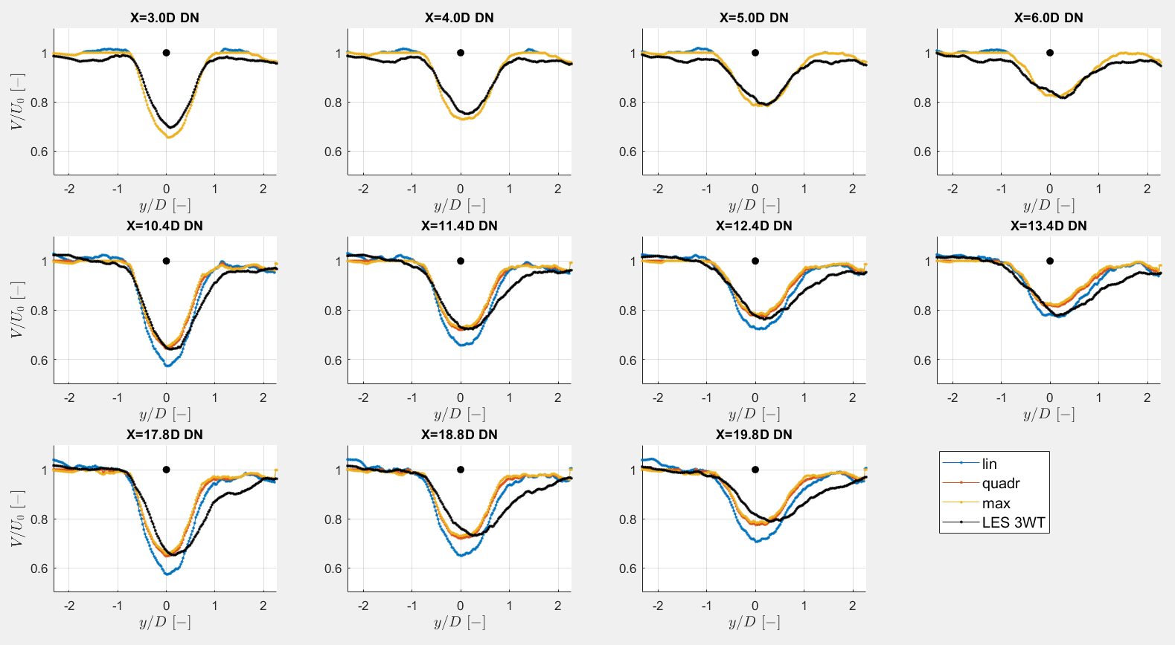
LES Superposition
Notes:
Assymetrical wake

Slide 32
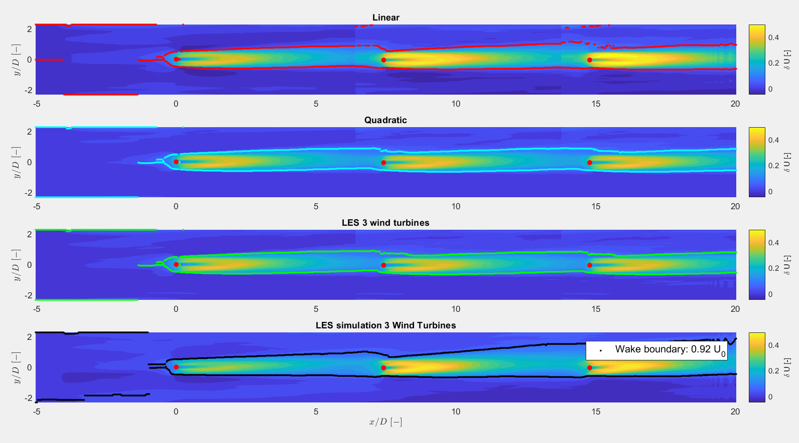
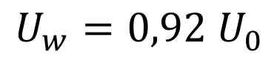
LES Superposition
$$U_{w}=0,92 U_{0}$$

Slide 33
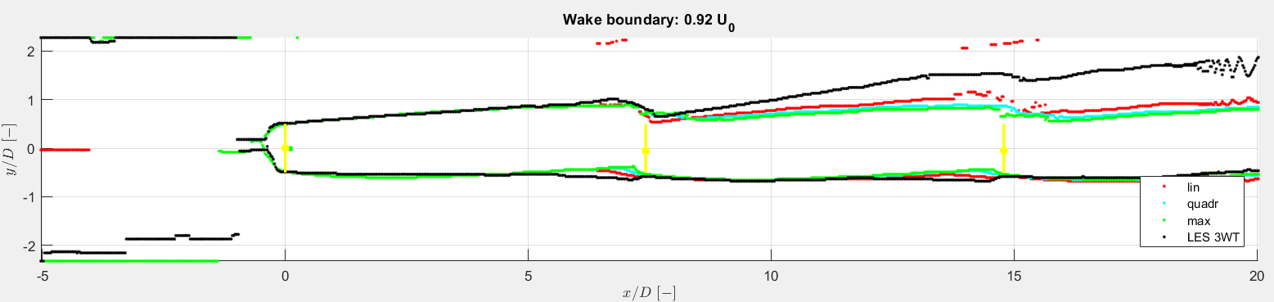
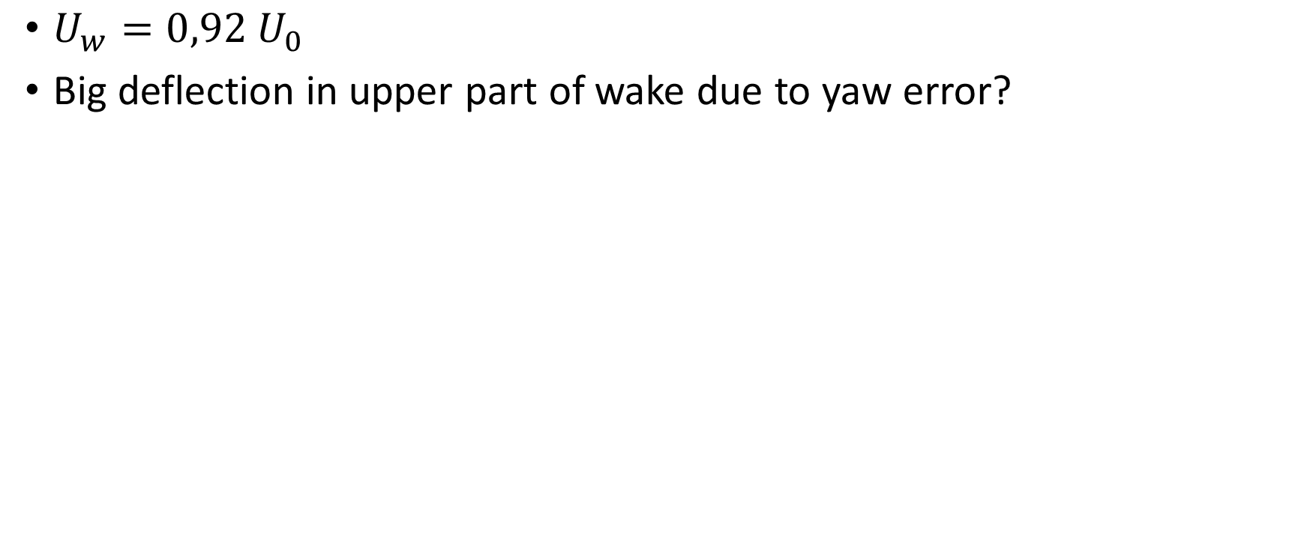
LES Superposition
$U_{w}=0,92 U_{0}$
Big deflection in upper part of wake due to yaw error?

Slide 34
Next steps

Slide 35
Next steps
New LES simulations (by Søren)
Other wind turbine
No yaw error, no veer, no shear, no extreme turbulence
Single wake (above and below rated wind speed)
Three wind turbines (above and below rated wind speed)
LES superposition
Comparison with engineering models
Park, Fuga
Wind profile along line in streamwise direction
Horizontal wind profile
Wake boundary: polynomial fit possible?

Slide 36
Thesis Committee
TU Delft perspective
Full professor or associate professor | Michiel Zaaijer
Staff member Aerospace Eng | ?
Your DTU supervisor | Søren Juhl Andersen
If applicable: your company supervisor | Nicolai Gayle Nygaard
If applicable: your daily supervisor (PhD student) | /
DTU perspective
Your DTU supervisor | Søren Juhl Andersen
Your TU Delft supervisor | Michiel Zaaijer
External examiner (CensorNet) it happens that Gerard van Bussel, Carlos Ferreira and Roland Schmehl are on that list. | ?

Slide 37
Questions?

Slide 38
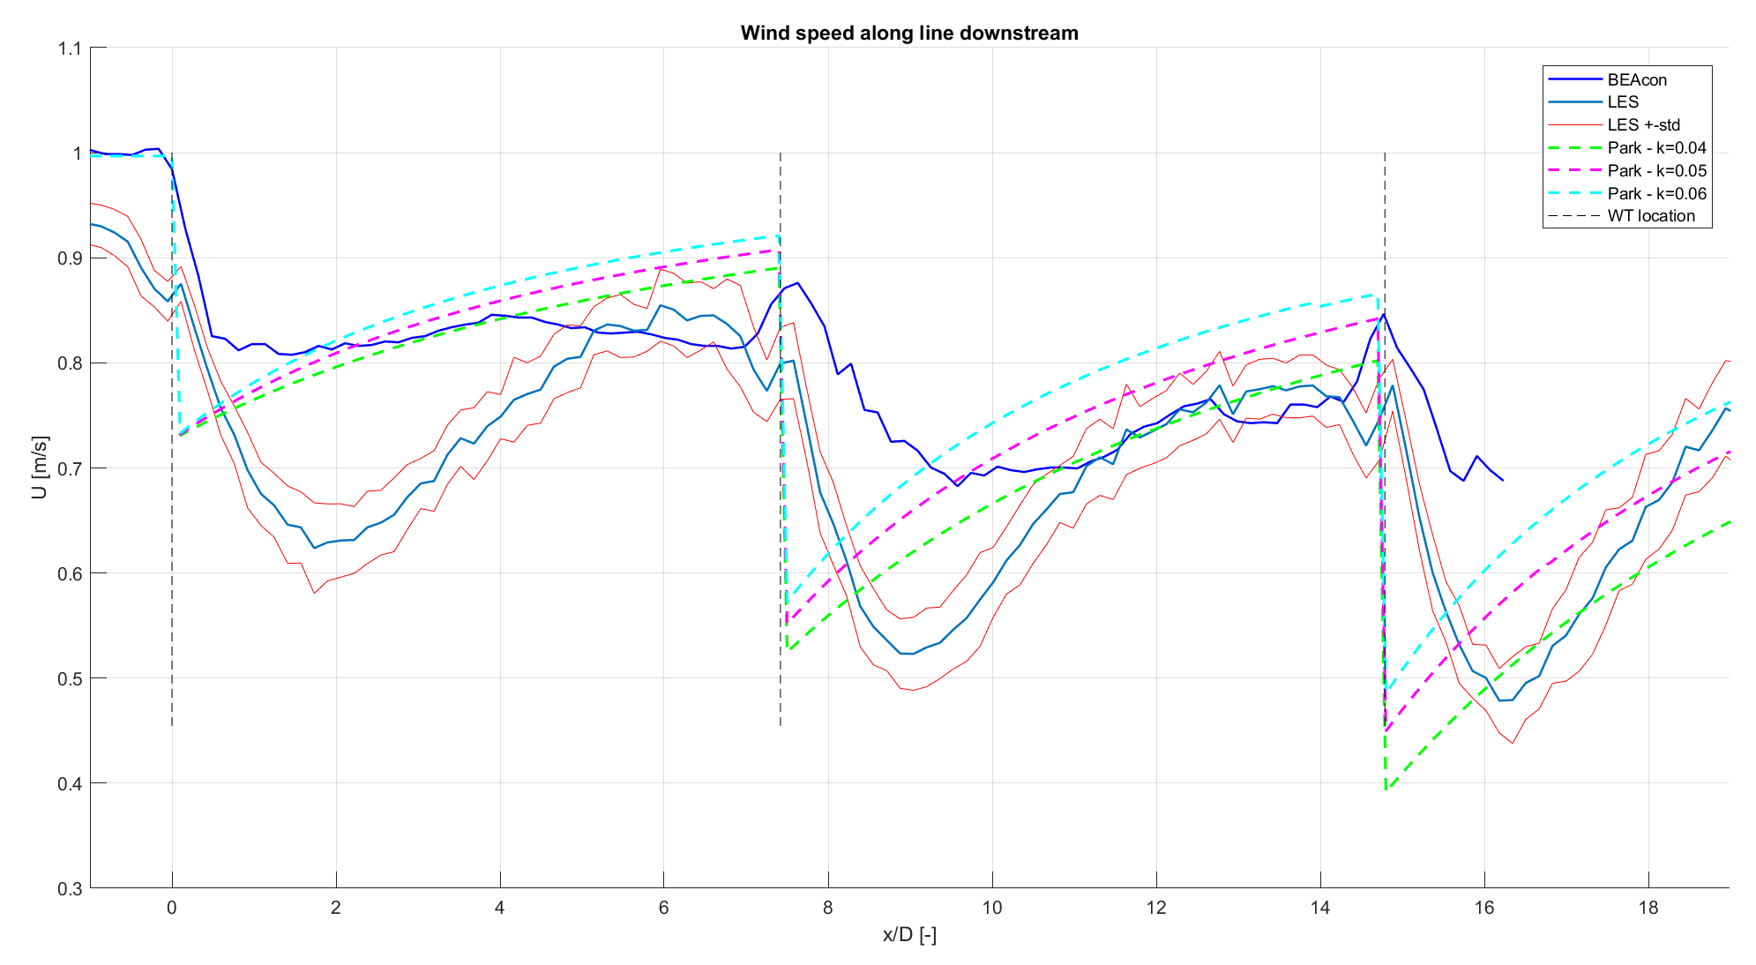
Comparison data & Park (Case 1)
Data at 100m height Park: quadratic superposition, with correction factor and wake reflection

Slide 39
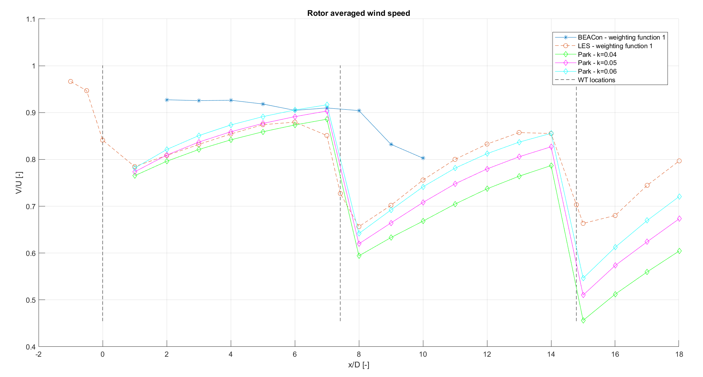
Comparison data & Park (Case 1)
Park: quadratic superposition, with correction factor and wake reflection

Slide 40
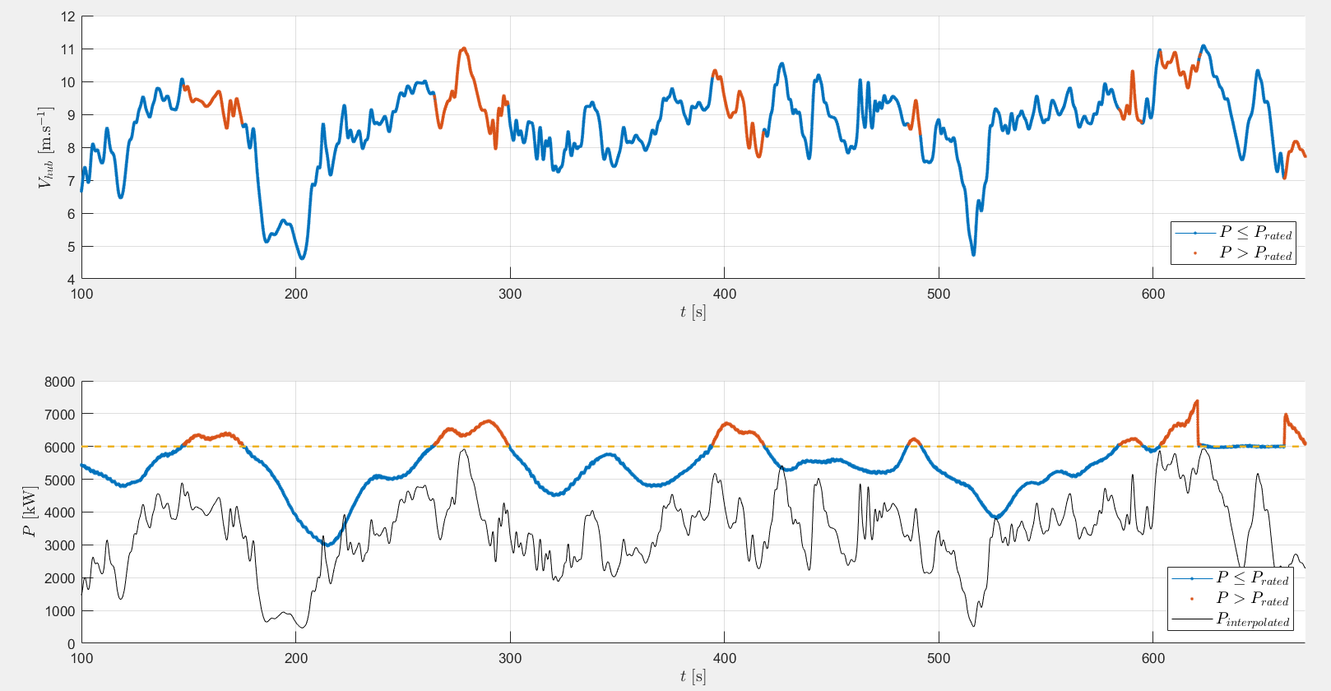
LES
Notes:
Vhub: wind speed 1R upstream of hub
Case 3

Slide 41
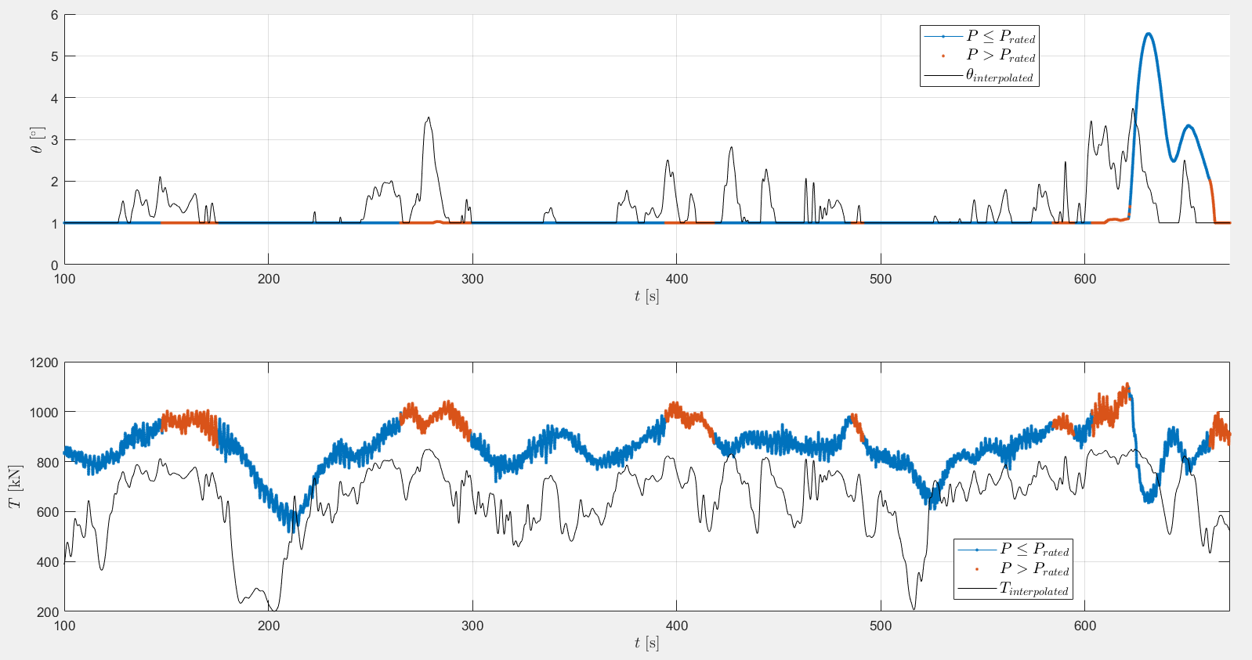
LES
Notes:
Case 3

